Slide 1

PROJECT STATEMENT
Use Azure Data Factory to move and organize data in Azure Data Lake Storage, and leverage Azure Databricks for data processing and analytics on the data stored in the Data Lake.

Slide 2
Project Overview
The project aims to design and implement a comprehensive data solution using Azure Data Factory (ADF) for efficient movement and organization of data in Azure Data Lake Storage (ADLS).
This creates a robust end-to-end solution for data integration, organization and advanced analytics, combining the strengths of Azure Data Factory and Azure Databricks to encounter efficient and scalable processing of data stored in Azure Data Lake Storage.
Azure Databricks will be utilized for advanced data processing and analytics on the stored data within the Data Lake.

Slide 3
PREREQUISITES
1
Azure Subscription:
An active Azure subscription to deploy and manage resources.
2
Access Rights:
Appropriate rights for Azure Data Factory, Data Lake Storage and Databricks.
3
Data Sources:
Implementing error handling mechanisms is crucial to manage exceptions and recover from data extraction failures, ensuring data integrity and reliability.

Slide 4
Azure Data Factory
Azure Data Factory is Azure's cloud ETL service for scale-out serverless data integration and data transformation. It offers a code-free UI for intuitive authoring and single-pane-of-glass monitoring and management.

Slide 5
AZURE DATA LAKE STORAGE
Azure Data Lake Storage is a cloud-based, enterprise data lake solution. It's engineered to store massive amounts of data in any format, and to facilitate big data analytical workloads. You use it to capture data of any type and ingestion speed in a single location for easy access and analysis using various frameworks.

Slide 6
AZURE DATABRICKS
Azure Databricks is a unified, open analytics platform for building, deploying, sharing, and maintaining enterprise-grade data, analytics, and AI solutions at scale.

Slide 7
OVERVIEW OF DATA MOVEMENT AND ORGANIZATION capabilities in Azure Data Factory
1
Efficient Data Movement
2
Robust Data Organization
Azure Data Factory provides efficient data movement across various sources and destinations, enabling seamless data transfer and organization.
It offers robust data organization capabilities, allowing you to structure and catalog data for easy access and analysis.

Slide 8
CONFIGURE AND SET UP AZURE DATA FACTORY TO MOVE AND ORGANIZE DATA IN AZURE DATA LAKE STORAGE
Connectivity Options
Data Flow Orchestration
Azure Data Factory supports a wide range of connectivity options to access and integrate data from disparate sources.
It facilitates the orchestration of data flows, allowing you to define and manage complex data processing and movement tasks.

Slide 9


INTRODUCTION TO AZURE DATABRICKS AND ITS CAPABILITIES FOR DATA PROCESSING AND ANALYTICS
Data Processing Power
Integration with Azure Services
Azure Databricks provides powerful data processing capabilities, including advanced analytics and machine learning.
It seamlessly integrates with various Azure services, enabling comprehensive data processing and analytics workflows.

Slide 10
LEVERAGING AZURE DATABRICKS NOTEBOOKS FOR DATA TRANSFORMATION
Exploring the use of Azure Databricks notebooks for data transformation tasks, including cleaning, aggregating, and enriching data.

Slide 11
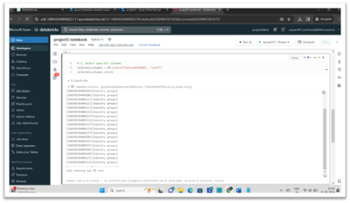
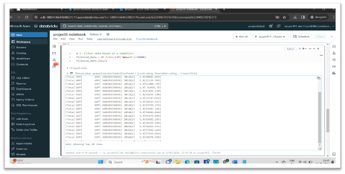
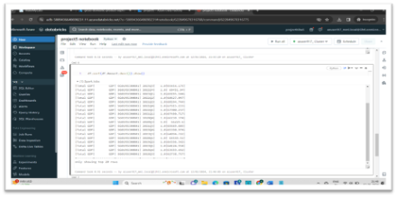
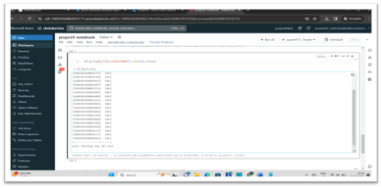
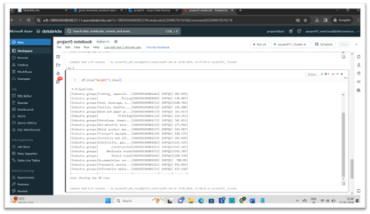
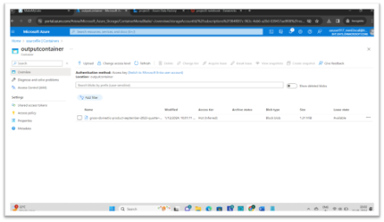
OUTPUT
As a part of the execution these are the transformations which are performed for the data processing
The json file is stored in the destination container

Slide 12
THANK YOU

